Slide 1
Data Storage and Access 1
IN721 2017
Design and Development for Mobile Devices
Session 8.1
Notes:
As our applications get bigger, it will become necessary to handle persistent data – that is, contents that are not created at runtime, like the array of ToDo activities, lists of words for the language trainer, etc., that we have used up until now.
There are two primary types of information storage we need:
Configuration data (preferences and settings)
Content data (e.g. the word list for the language trainer, sets of images for the Welcome to Dunedin app, etc.)
Android provides one primary technique for the former, and several for the latter.
We will spend all week on this, covering the topic in two parts…

Slide 2
Techniques
Part 1:
SharedPreferences
Simple File I/O
SQL Databases
Part 2:
Formatted File I/O
Notes:
SharedPreferences is for configuration data, and you will see that it is much like ViewState, Session, and so on
The others are for external content. If we were looking simply in order of increasing data complexity, we would probably do SQL databases last. However, we already know about SQL databases and, more critically, we need to spend extra time on formatted files, because we are going to need to be very comfortable with them when we start getting data off the internet.

Slide 3
SharedPreferences
Associative array (key-value pairs) for storing simple persistent data elements.
Persists between application launches.
Notes:
So this is how you would hold a font size, or a background colour, or a high score.
In fact, your sharedpreferences will stay around until you uninstall the app.
As an example, consider the globalisation issue of what language to make your display in.
We will build a simple app that displays its Hello World in different languages, depending on the user choice.
When the app is first launched, the user is instructed (in English) to select their preferred language.
On subsequent launches, the app should just open up already in that language.

Slide 4
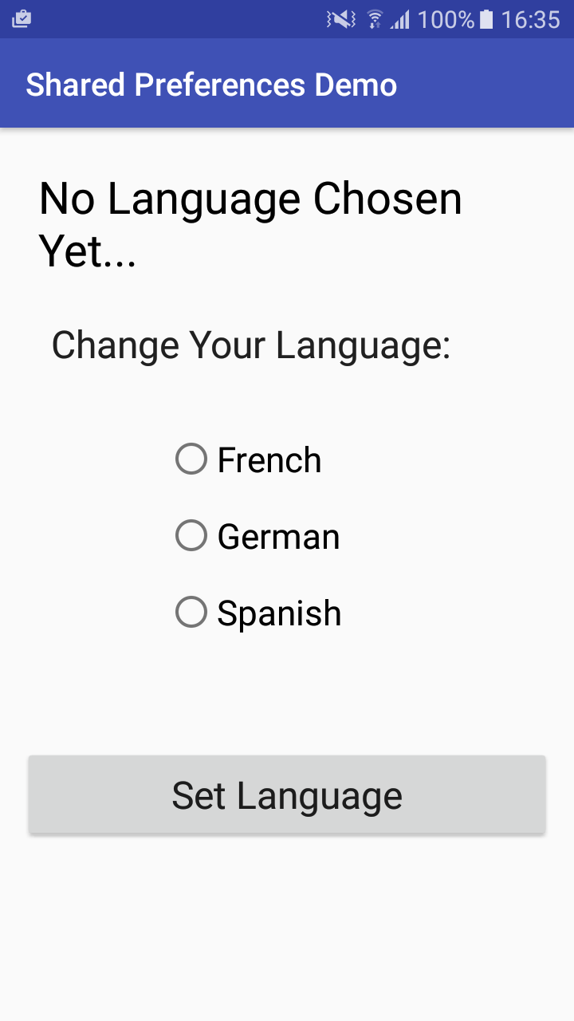
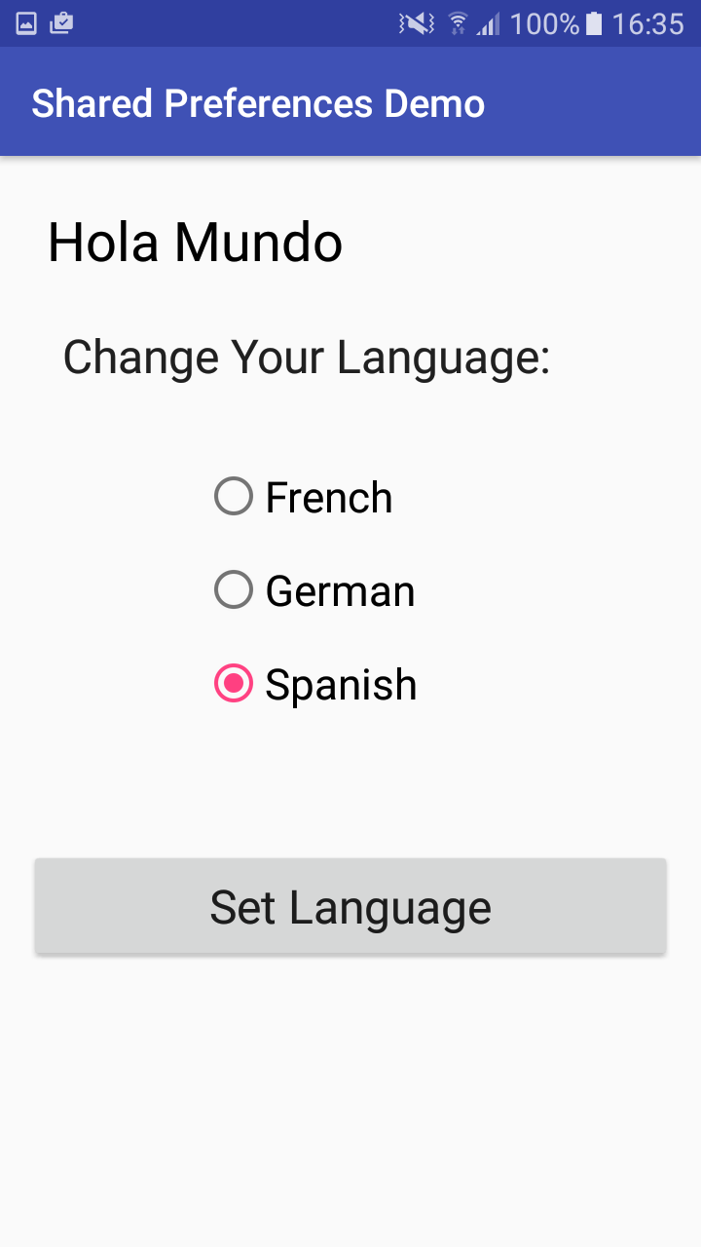
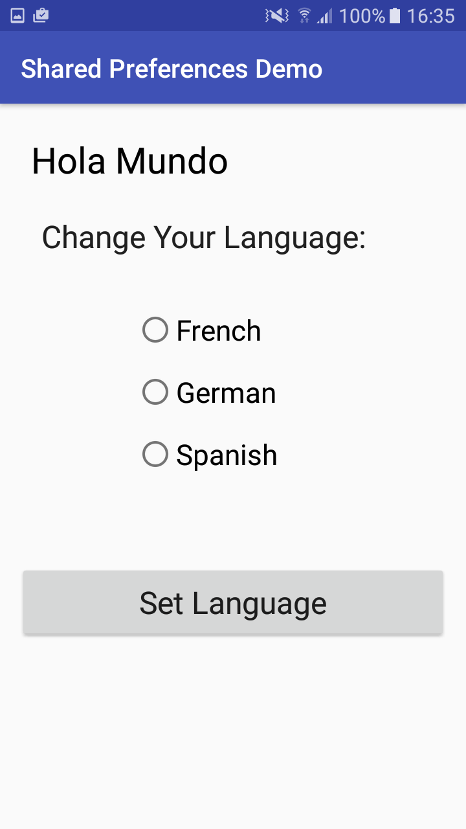
SharedPreferences
Notes:
Opening screen
After selection
Opening screen on subsequent launch. (Closed the emulator, changed and relaunched the app).
The logic is:
On create, the system reads from sharedPreferences. If the key is null, it shows the default screen. But if the key is there, it sets the text.
The button click handler reads from the radiogroup and writes the key value pair to sharedPreferences’

Slide 5
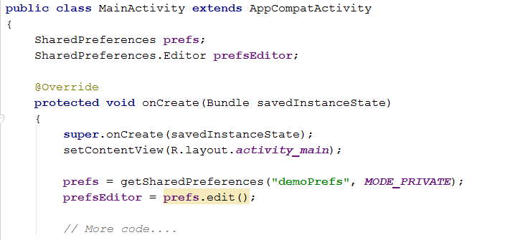
SharedPreferences
To use SharedPreferences you need:
An instance of the SharedPreferences class
An instance of the Editor class
Notes:
SharedPreferences is, of course, an Android class
When you store something in a SharedPreferences instance, the data are written to local storage on the phone in persistent private memory associated with the app.
On subsequent launches, the values are retrieved and reinstantiated.
In addition to your SharedPreferences instance, you need an instance of Android class Editor. This is the class that does the actual writing.
You will create the Editor by calling a method of the SharedPreferences object.
Because these objects will potentially be used by many different methods in the Activity, declare them as class fields.
In our globalisation demo, our Activity class declaration might start like this…
We get our sharedPreferences object in the familiar way, by calling an Activity method, getSharedPreferences
In the getSharedPreferences call, you supply a name for the SharedPreferences file (so other activities can access the same storage) and a mode, in this case, the sharedpreferences is available only within this app. Other options are WORLD_READABLE, WORLD_WRITABLE and MULTI_PROCESS. See the docs for details.
The getSharedPreferences method is smart. When it is called, it looks for a pre-existing stored sharedPreferences called “demoPrefs”. If there isn’t one (i.e. the first time), it creates and returns it. If there is (every subsequent time) it fetches and returns it.
We then use prefs to call the edit() method of its class. This returns an Editor object which is bound to the Shared Preferences object, and which we will use to write key-value pairs to it.
We want to concentrate on this syntax atm, but there will be more code here. To ensure that the app starts in the previously set language, we will need to try to fetch the stored value. If it has been set we will use it. If not, we’ll leave the default message.
We will first look at how to set it, then come back to the rest of onCreate

Slide 6
SharedPreferences
To write to a SharedPreferences object with its Editor:
editorName.putString(“key”,value);
// all other puts…
editorName.commit();
Other Editor methods include putBoolean, putFloat, putInt, putStringSet and remove(key)
Notes:
Writing to the sharedPreferences needs to be atomic.
Do all your changes, then commit
Do you see why? => The activities in your app are going to share this SharedPreferences, if this one suddenly gets onPaused, you don’t want the next guy accessing some half-changed SharedPreferences, perhaps in an illegal state. So, it’s done this way.
The other methods all take a key and a value, except remove, which just takes a key.
Let’s look at how we write to the SharedPreferences object in our globalised Hello World app…

Slide 7
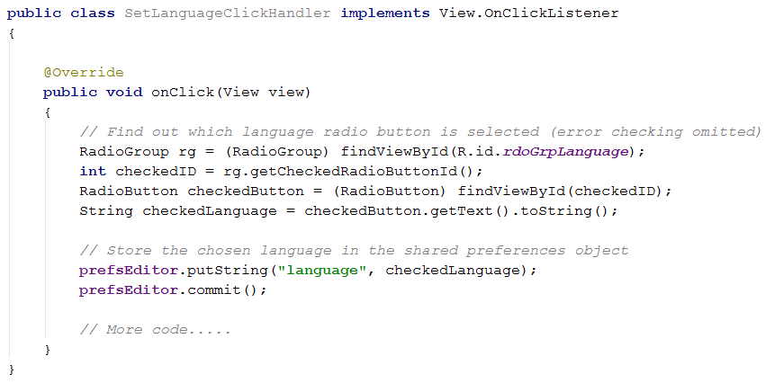
SharedPreferences
Notes:
Here is the button click handler method for the Set Language button.
Start by getting the text of the selected radio button. This should be familiar to you from your Language Trainer.
Then we store that value in SharedPreferences with a key of “language”.
Recall that we made prefsEditor and class field and initalised it in the onCreate. That way we don’t have to recreate it in every method where we want to use it.
We will need some more code to update the display at this point. That is standard. The user’s preference will persist when the app is restarted, but they shouldn’t have to quit and restart to see it happen.
The code we use to set the display here and the code we use to set it onCreate will both need a way to get the greeting in the correct language. Let’s make that a little method...

Slide 8
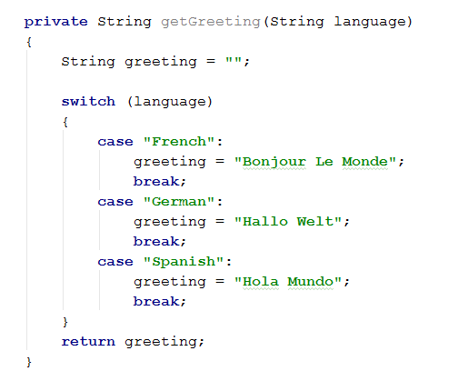
SharedPreferences
Notes:
You might want to think about what you would do if you had 100s of languages…
What do we need in the onCreate to make sure the app opens in the correct language each time?

Slide 9
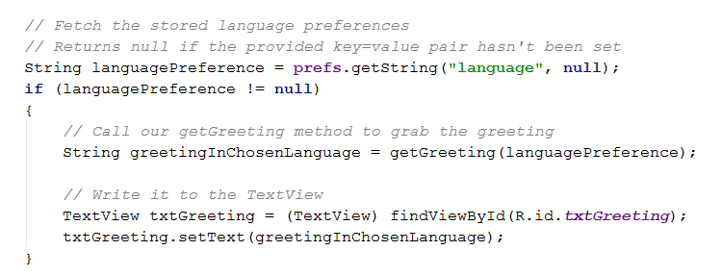
SharedPreferences
Notes:
Where does this code go? => In the onCreate
What else do we need to do in the onCreate (we have already created the sharedPrefs and its editor)
Wire up the button
Clear the radiogroup
About the creation or retrieval of the SharedPreferences object name “prefsDemo”, which we saw before. As mentioned then, the first time the app is run, this code creates and stores it. On subsequent launches, it fetches it, and any contents it holds.
This object stays in the phone’s physical memory until the app is uninstalled.
Now the new code:
We see getString. NB: This is a method of the SharedPreferences object, not of its Editor. The Editor is only for modifying the key-value store (put, remove, commit, etc.)
Fetch by key, and provide the default value is it’s not there.
Check to see if it was there (i.e. it was set at some previous run of the app)
If so, update the textview.
The user always sees the correct text.
Where else do we need to do this? => In the button click handler, so the greeting also changes on click
Putting all the code together is left as an exercise in the practical. Feel free to move code into methods to avoid duplication.

Slide 10
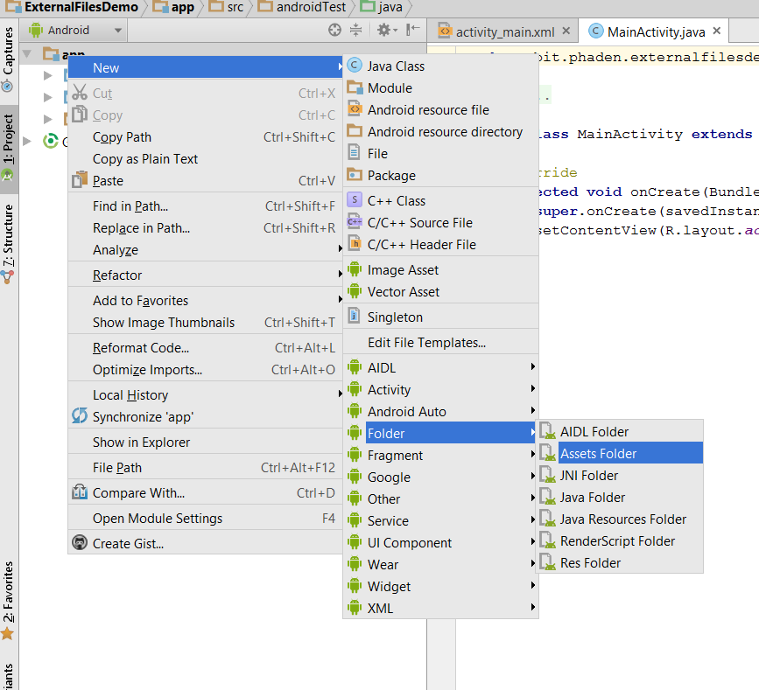
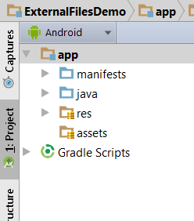
Simple File I/O
Text files are conventionally placed in the ~/assets folder.
Notes:
Often we need to store content for our apps.
For the next example, imagine that we want to store a long list of cities to display in some kind of collection control (perhaps for a hotel reservation or airline bookings app)
We have previously seen that we can store lists of things in res/value as a string array, but when the lists get longer than just a few items, that becomes very tedious, and requires recompilation to modify.
Eventually, we will need to be able to open and read a text file.
NB: In all slides in the powerpoint, try-catch has been removed to save space. For some operations, they are mandatory, and Java will flag you for them.
Text files for input should go in ~/assets
Android provides an AssetManager class that looks for this folder.
You will need to create ~/assets, as shown.

Slide 11
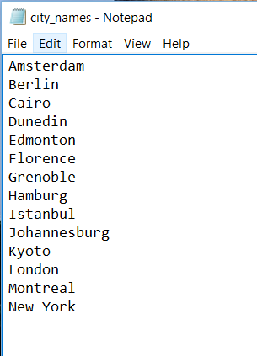
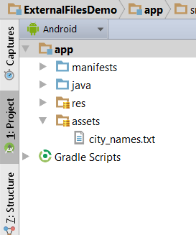
Simple File I/O
Notes:
We will start with a simple ascii file containing a list of cities, city_names.txt
It only has 14 cities, but the process is identical for 1000s
Copy and paste it into your new assets folder...

Slide 12
Simple File I/O
To use files from ~/assets you need an AssetManager
To create a BufferedReader:
Get an InputStream using AssetManager
Use InputStream to create InputStreamReader
Use InputStreamReader to create BufferedReader
Notes:
Shouldn’t be a big surprise by now.
Activities have all kinds of helpers, and get methods to grab them. This is just another one.
To read from an external file, you want to get a BufferedReader (this is a normal Java.io class, not an Android class) It has the most useful I/O operations.
Getting a BufferedReader is a three-step process.
First you get a system input stream, using the assetmanager
Then you use the inputStream to create an InputStreamReader
Finally you use the InputStreamReader to create a BufferedReader
In code, it looks like this…

Slide 13
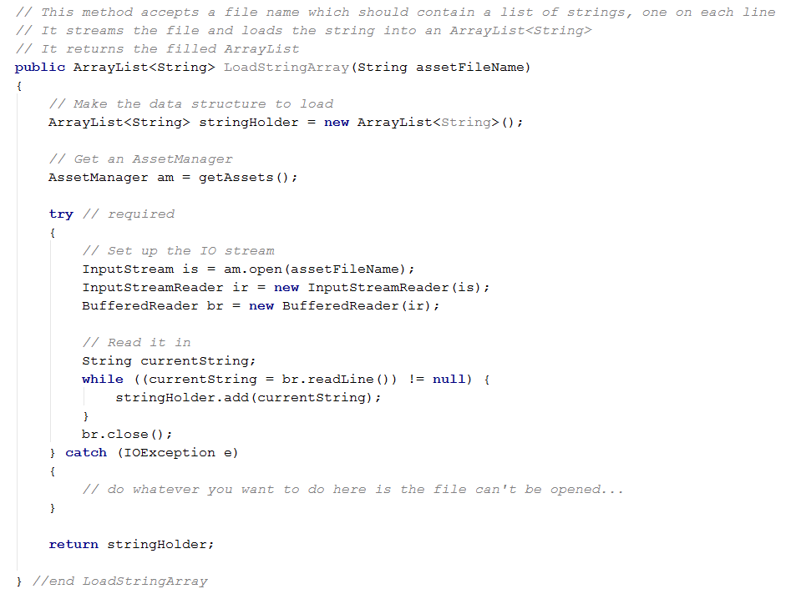
Simple File I/O
Notes:
Fussy code. This is normal Java, not Android. We’ll go through it here for those who haven’t done Java.
You should always wrap attempts to open external resources in a try-catch and give sensible feedback before (or instead of) crashing.
In fact, AS will require you to do so. We’ll see that code later. For now we want to concentrate on this part...
Once you have a BufferedReader, you are back in normal I/O stream territory
We have the familiar “loop until readLine returns false” pattern.
You now have a nice collection of strings that you can pass off to an ArrayAdapter and put into a ListView…
You can just give the file name without path info – the asset manager gets it out of the asset folder for you.

Slide 14
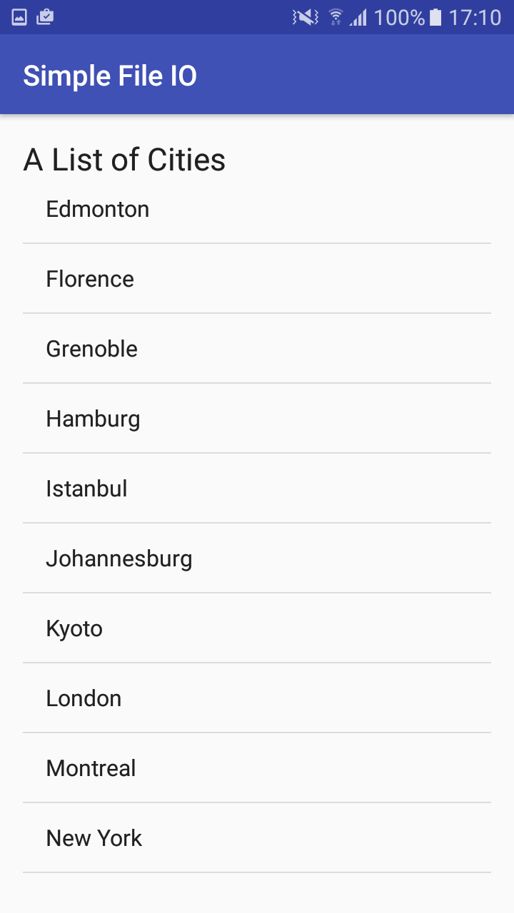
Simple File I/O
Notes:
Like this. I’ve loaded the listview in the oncreate. You can see here that I have scrolled down to see the later entries.
You’ll be doing this in your practical

Slide 15
Using an SQL Database
SQLite
tblCity(cityID, cityName, countryName)
Notes:
If your internal data model becomes sufficiently complex, you may want to put a database behind it.
Luckily, Android comes with a built-in RDBMS, SQLite.
Because you have done so much RDBMS stuff in DB2 and Web 2, and because you are doing so much of it in Web 3, we aren’t going to spend too much time talking about how it’s done in Android.
We will just look at how to communicate with the RDBMS using Android libraries, and you will have a chance to use it in the practical.
For our example, we will make our Cities entity more complex by including the country in which it is found. You have decided that you want a database for this. We will use a single table, as shown.
Working with SQLite in Android is just what you’re familiar with. Get the appropriate helper objects. Write SQL and pass it to the objects.
NB: There is a wrapper class for this called SQLiteDatabase that is not really easier to work with, but is more efficient if you’ve got lots of database work to do. See the docs for details.

Slide 16
Using an SQL Database
Process:
Declare an SQLiteDatabase object instance
Initialise the instance via openOrCreateDatabase
Write SQL queries; store in String variables
Pass queries to SQLiteDatabase.execSQL

Slide 17

Using an SQL Database
Accessing (or creating) a database
Notes:
Note the openOrCreateDatabase command is an Activity method.

Slide 18
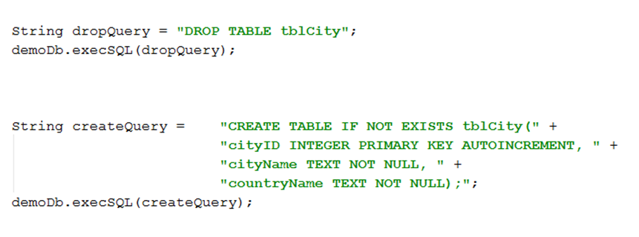
Using an SQL Database
Dropping and creating tables
Notes:
SQLite uses a slightly different SQL syntax from T-SQL or mySQL (of course). Note the declaration of the primary key and TEXT data type
See the docs for full details.
Note the openOrCreateDatabase command is an Activity method.
execSQL is an SQLiteDatabase class method.

Slide 19
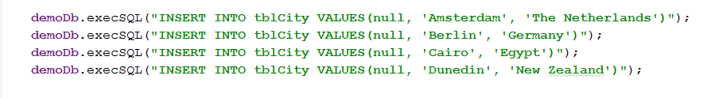
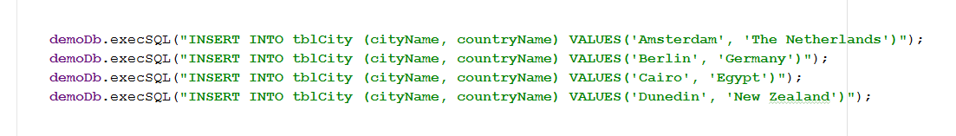
Using an SQL Database
Inserting records
Notes:
(Combining string declaration and method call to save space…)
This is a place that SQLite is particularly odd.
With an autoincrement field, you pass in null. You’ll get a number-of-arguments exception if you don’t
As an alternative, use a fully qualified insert statement
Either approach produces a correct unique PK

Slide 20
Using an SQL Database
Select queries
Use SQLiteDatabase.rawQuery method
Returns a Cursor object (a record set)
Useful Cursor methods:
getColumnCount()
getCount()
getColumnIndex(String columnName)
moveToFirst()
moveToNext()
getString(int index)
developer.android.com/reference/android/database/Cursor.html
Notes:
Like with mySQL and php, select queries return a packed up data object that you have to untangle to look at the records
getCount returns the number of records fetched
Everything else is self-explanatory
There are lots more methods
Here’s how we could do a SELECT * on our table and pull the city and country names out into an ArrayList…

Slide 21
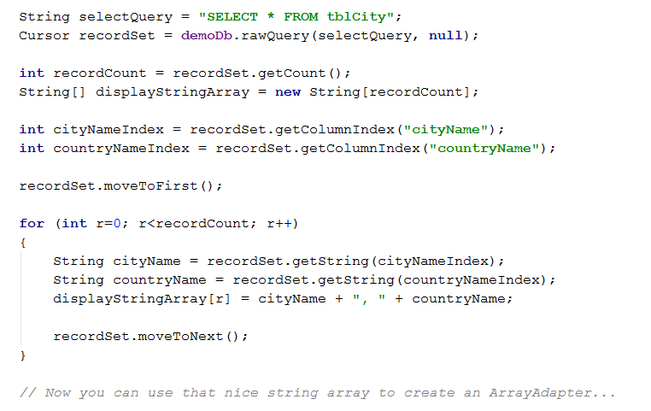
Using an SQL Database
Notes:
Here, we know the citynameindex so we could have hard-coded it in, but this code will continue to work if the table schema is changed later, which is always good technique.
At the end of this, again you have a nice array that you can shove into the ListView.
You will have a chance to do this in the practical.

Slide 22
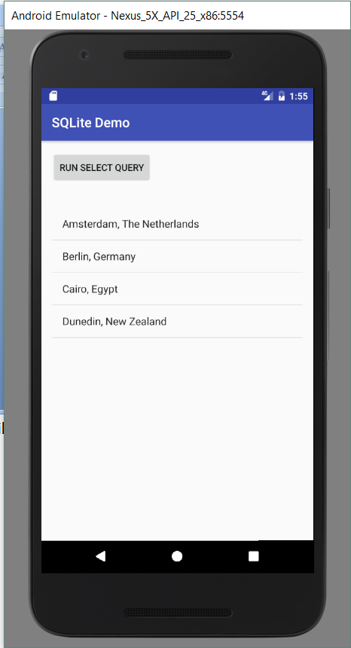
Using an SQL Database
Notes:
Here’s what it looks like if you hit the database inside the button click...

Slide 23
Practical

